Slide 1

Curved Crystal Analyzers
Xianbo Shi
Optics Group, Advanced Photon Source

Slide 2
X-ray Emission Spectrometer Geometry
Non-dispersive (scanning)
Point-to-point/line focusing
Spherically bent crystal
Johann geometry
Johansson geometry
Other geometry
Dispersive
von Hamos
“In-circle” dispersive geometry
Flat crystal (miniXES)
Analyzer expensive
Detector expensive
Beamline Optics Design and Simulation Workshop 2025

Slide 3
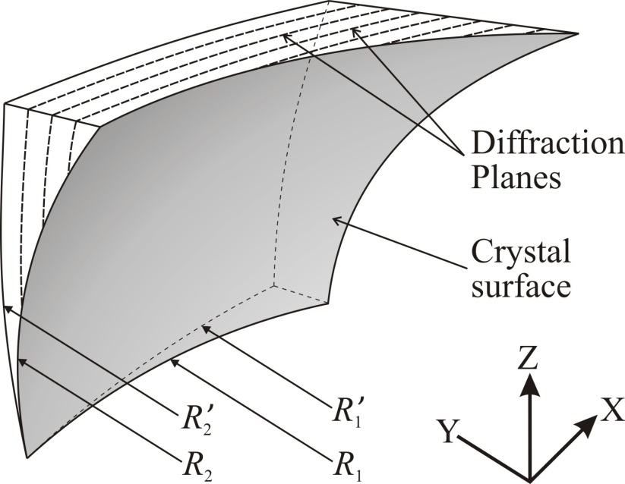
Non-dispersive Geometry
Case | R₁ | R’₁ | R₂ | R’₂
Johann | 1 | 1 | ∞ | ∞
Johansson | 1/2 | 1 | ∞ | ∞
Spherical Plate | 1 | 1 | 1 | 1
Wittry | 1/2 | 1 | 1 | 1
General focusing | 1/2 | 1 | sin²θ_{B} | sin²θ_{B}
P. Jalal and A. Golamreza, J. Opt. Soc. Am. A 29 (2012) 68-77
Resolution and solid angle depends on
Intrinsic broadening due to bending (XOP Bent_Crystal)
Geometric effect (ray tracing)
Beamline Optics Design and Simulation Workshop 2025

Slide 4
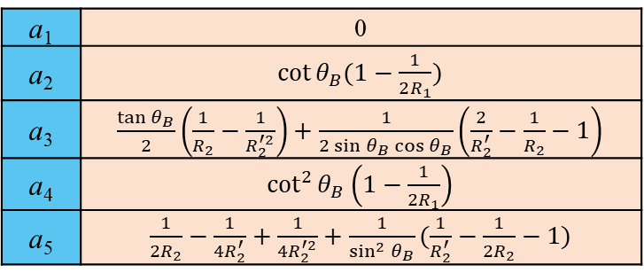
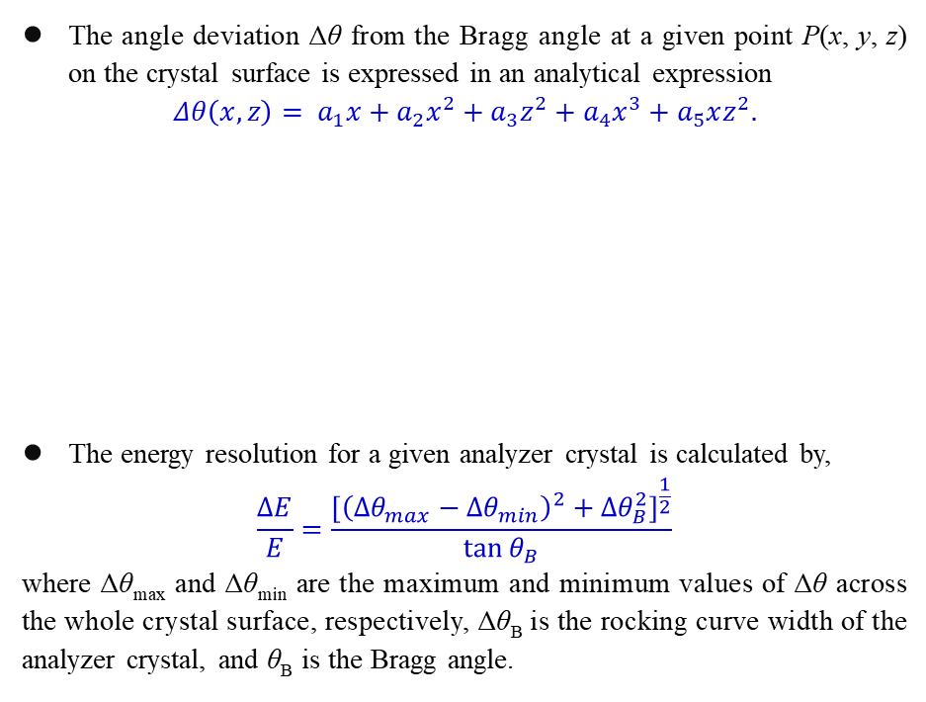
Effective Solid Angle
The angle deviation Δθ from the Bragg angle at a given point P(x, y, z) on the crystal surface is expressed in an analytical expression
$$Δθ\left(x,z\right)= a_{1}x+a_{2}x^{2}+a_{3}z^{2}+a_{4}x^{3}+a_{5}xz^{2}.$$
The energy resolution for a given analyzer crystal is calculated by,
$$\frac{ΔE}{E}=\frac{{\left[{\left(Δθ_{max}−Δθ_{min}\right)}^{2}+Δθ_{B}^{2}\right]}^{\frac{1}{2}}}{\tan{θ_{B}}}$$
where Δθ_{max} and Δθ_{min} are the maximum and minimum values of Δθ across the whole crystal surface, respectively, Δθ_{B} is the rocking curve width of the analyzer crystal, and θ_{B} is the Bragg angle.
a₁ | 0
a₂ | $\cot{θ_{B}(1−\frac{1}{2R_{1}})}$
a₃ | $\frac{\tan{θ_{B}}}{2}\left(\frac{1}{R_{2}}−\frac{1}{R_{2}^{′2}}\right)+\frac{1}{2\sin{θ_{B}\cos{θ_{B}}}}\left(\frac{2}{R_{2}^{′}}−\frac{1}{R_{2}}−1\right)$
a₄ | $\cot^{2}{θ_{B}\left(1−\frac{1}{2R_{1}}\right)}$
a₅ | $\frac{1}{2R_{2}}−\frac{1}{{4R}_{2}^{′}}+\frac{1}{{4R}_{2}^{′2}}+\frac{1}{\sin^{2}{θ_{B}}}(\frac{1}{R_{2}^{′}}−\frac{1}{2R_{2}}−1)$
Case | R₁ | R’₁ | R₂ | R’₂
Johann | 1 | 1 | ∞ | ∞
Johansson | 1/2 | 1 | ∞ | ∞
Spherical Plate | 1 | 1 | 1 | 1
Wittry | 1/2 | 1 | 1 | 1
General focusing | 1/2 | 1 | sin²θ_{B} | sin²θ_{B}
Beamline Optics Design and Simulation Workshop 2025

Slide 5
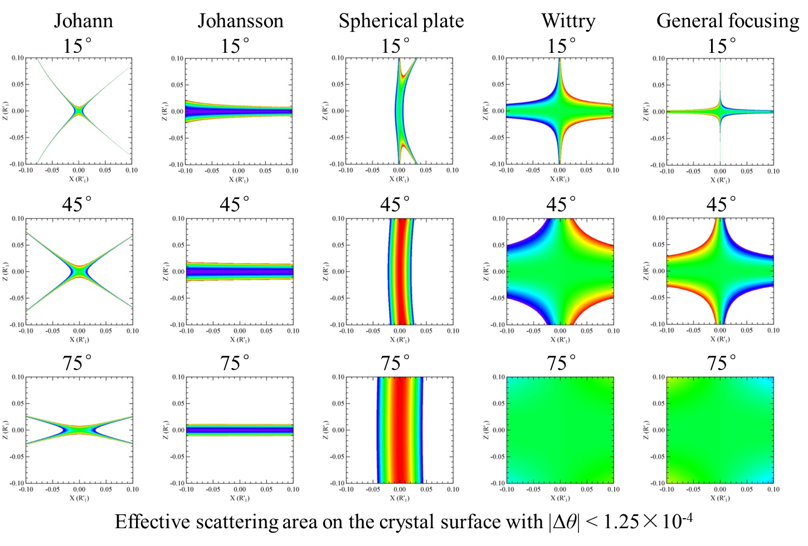
Effective Solid Angle
Beamline Optics Design and Simulation Workshop 2025

Slide 6
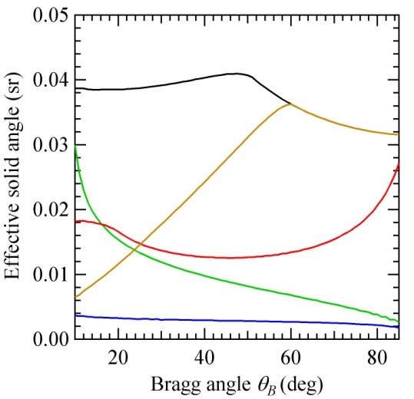
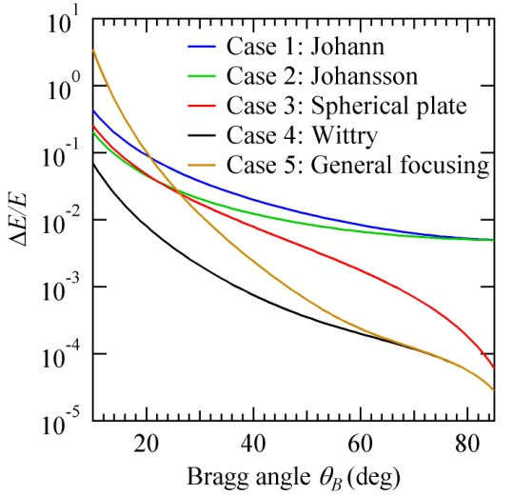
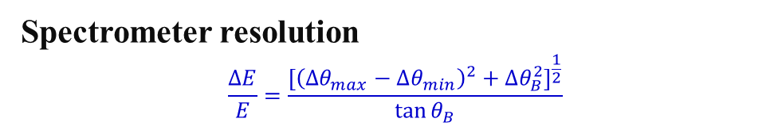
Effective Solid Angle
Effective solid angle for |Δθ|<Δθ_{ref}/2, Δθ_{ref} is chosen based on
The intrinsic width of the rocking curve for the bent crystal:
For a Si333 crystal bent to 1 m, the width of the rocking curve is about 2.5×10⁻⁵ rad for 6.4 keV X-rays.
The natural width of the emission lines to be measured:
The Fe Kα emission line width is about 1.6 eV (ΔE/E = 2.5×10⁻⁴). For θ_{B} = 45°, the equivalent angle range is given by (ΔE/E ) tan θ_{B} = 2.5×10⁻⁴.
The finite source size (sample volume that is illuminated):
A 0.1 mm source at a source-to-crystal distance of 1 m gives an angle range of 1×10⁻⁴.
Spectrometer resolution
$$\frac{ΔE}{E}=\frac{{\left[{\left(Δθ_{max}−Δθ_{min}\right)}^{2}+Δθ_{B}^{2}\right]}^{\frac{1}{2}}}{\tan{θ_{B}}}$$
Beamline Optics Design and Simulation Workshop 2025

Slide 7
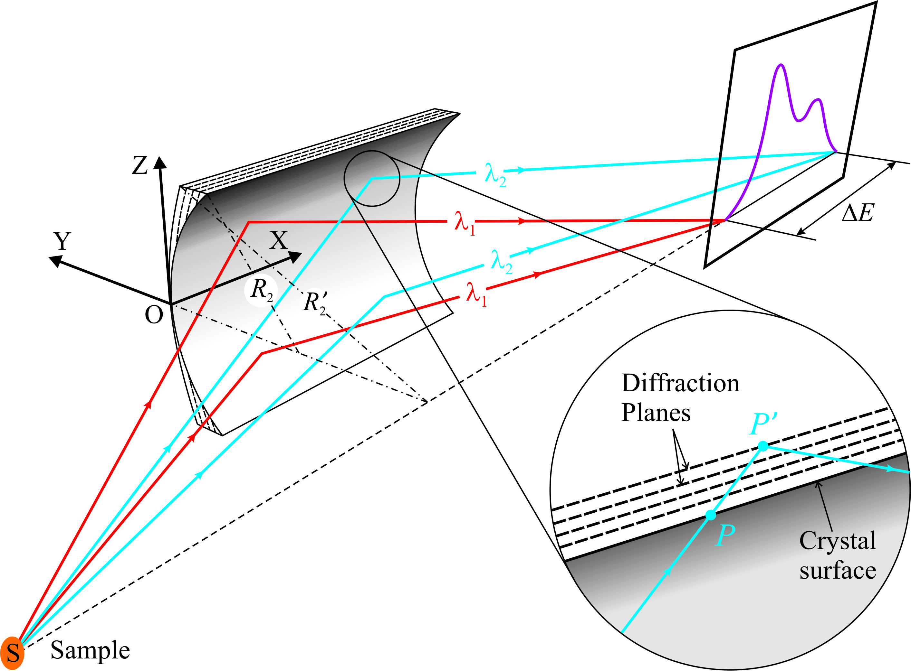
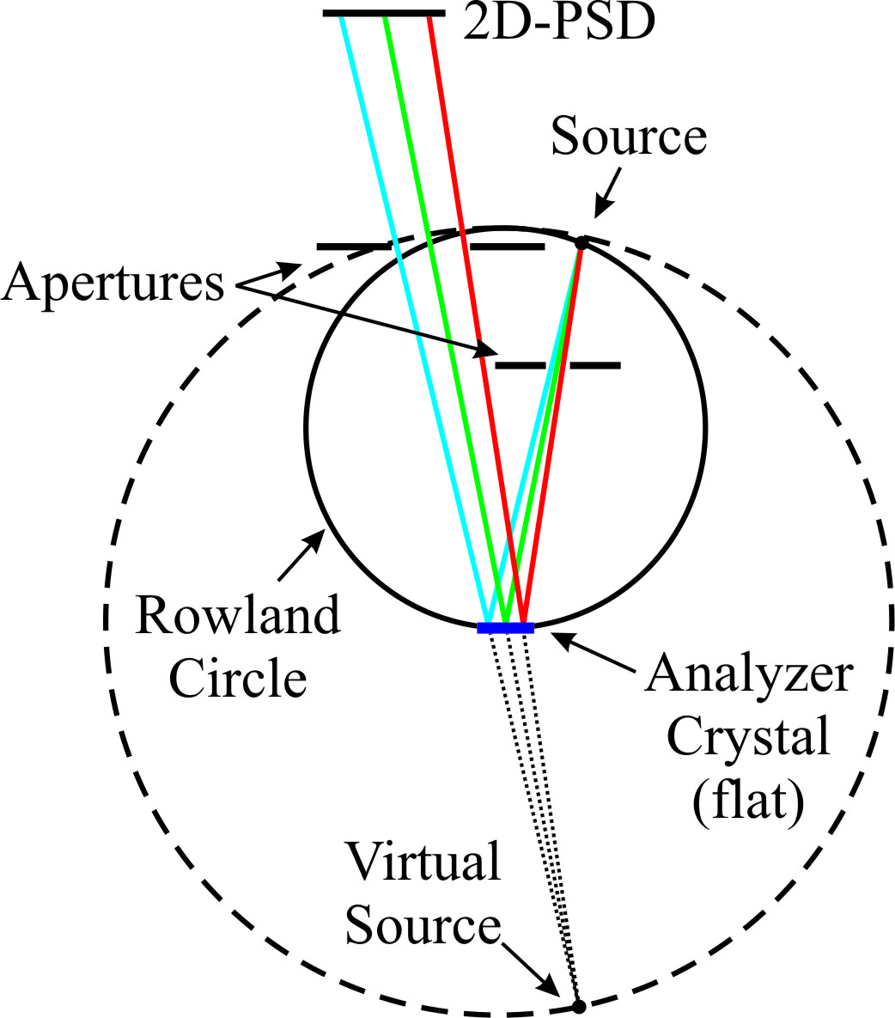
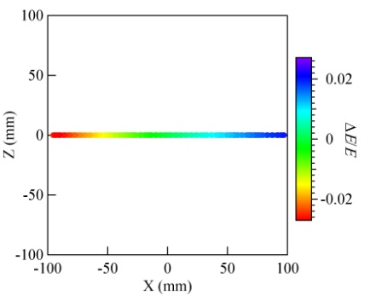
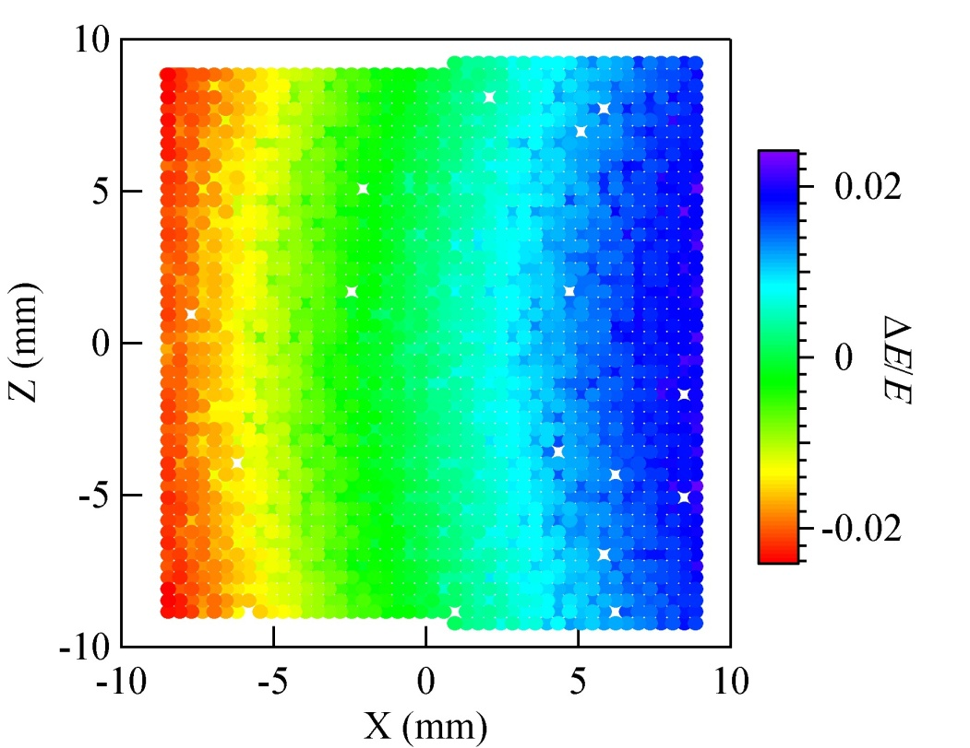
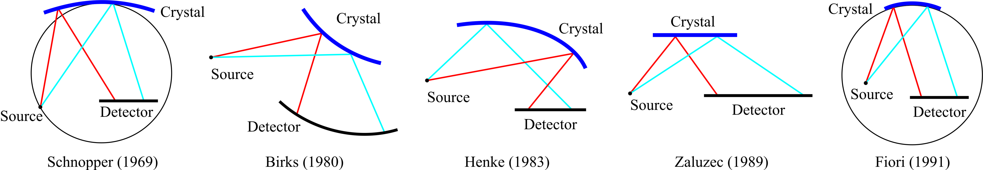
Dispersive Spectrometers
Von Hamos
Flat
Other parallel-detection spectrometers
B. A. Mattern, et al, Rev. Sci. Instrum. 83 (2012) 023901
D. B. Wittry and N. C. Barbi, Microsc. Microanal. 7 (2001) 124–141.
Beamline Optics Design and Simulation Workshop 2025

Slide 8
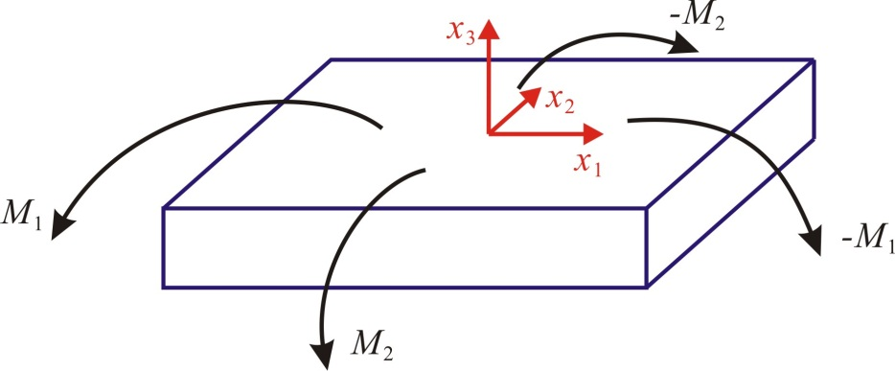
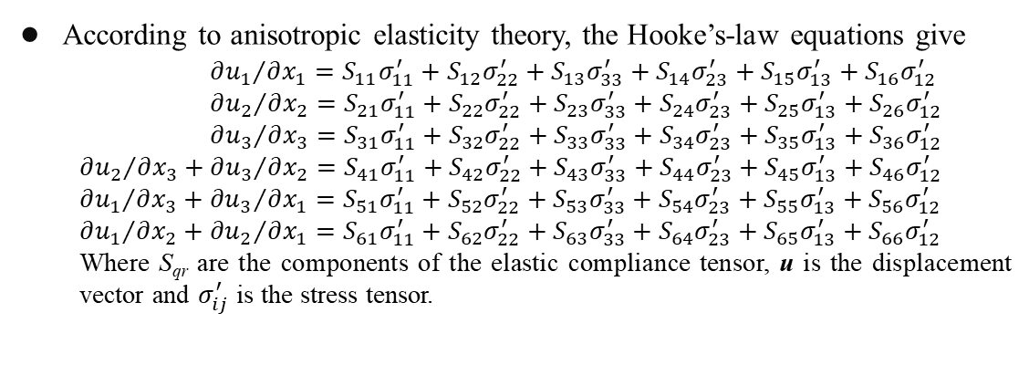
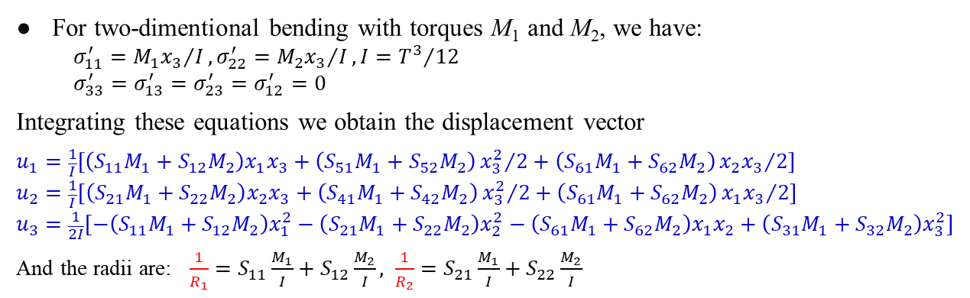
Crystal anisotropy and biaxial bending
According to anisotropic elasticity theory, the Hooke’s-law equations give
$${∂u_{1}}/{∂x_{1}}=S_{11}σ_{11}^{′}+S_{12}σ_{22}^{′}+S_{13}σ_{33}^{′}+S_{14}σ_{23}^{′}+S_{15}σ_{13}^{′}+S_{16}σ_{12}^{′}$$
$${∂u_{2}}/{∂x_{2}}=S_{21}σ_{11}^{′}+S_{22}σ_{22}^{′}+S_{23}σ_{33}^{′}+S_{24}σ_{23}^{′}+S_{25}σ_{13}^{′}+S_{26}σ_{12}^{′}$$
$${∂u_{3}}/{∂x_{3}}=S_{31}σ_{11}^{′}+S_{32}σ_{22}^{′}+S_{33}σ_{33}^{′}+S_{34}σ_{23}^{′}+S_{35}σ_{13}^{′}+S_{36}σ_{12}^{′}$$
$${∂u_{2}}/{∂x_{3}}+{∂u_{3}}/{∂x_{2}}=S_{41}σ_{11}^{′}+S_{42}σ_{22}^{′}+S_{43}σ_{33}^{′}+S_{44}σ_{23}^{′}+S_{45}σ_{13}^{′}+S_{46}σ_{12}^{′}$$
$${∂u_{1}}/{∂x_{3}}+{∂u_{3}}/{∂x_{1}}=S_{51}σ_{11}^{′}+S_{52}σ_{22}^{′}+S_{53}σ_{33}^{′}+S_{54}σ_{23}^{′}+S_{55}σ_{13}^{′}+S_{56}σ_{12}^{′}$$
$${∂u_{1}}/{∂x_{2}}+{∂u_{2}}/{∂x_{1}}=S_{61}σ_{11}^{′}+S_{62}σ_{22}^{′}+S_{63}σ_{33}^{′}+S_{64}σ_{23}^{′}+S_{65}σ_{13}^{′}+S_{66}σ_{12}^{′}$$
Where S_{qr} are the components of the elastic compliance tensor, u is the displacement vector and $σ_{ij}^{′}$ is the stress tensor.
For two-dimentional bending with torques M₁ and M₂, we have:
$$σ_{11}^{′}={M_{1}x_{3}}/I, σ_{22}^{′}={M_{2}x_{3}}/I, I={T^{3}}/{12}$$
$$σ_{33}^{′}=σ_{13}^{′}=σ_{23}^{′}=σ_{12}^{′}=0$$
Integrating these equations we obtain the displacement vector
$$u_{1}=\frac{1}{I}\left[\left(S_{11}M_{1}+S_{12}M_{2}\right)x_{1}x_{3}+\left(S_{51}M_{1}+S_{52}M_{2}\right){x_{3}^{2}}/2+\left(S_{61}M_{1}+S_{62}M_{2}\right){x_{2}x_{3}}/2\right]$$
$$u_{2}=\frac{1}{I}\left[\left(S_{21}M_{1}+S_{22}M_{2}\right)x_{2}x_{3}+\left(S_{41}M_{1}+S_{42}M_{2}\right){x_{3}^{2}}/2+\left(S_{61}M_{1}+S_{62}M_{2}\right){x_{1}x_{3}}/2\right]$$
$$u_{3}=\frac{1}{2I}[−\left(S_{11}M_{1}+S_{12}M_{2}\right)x_{1}^{2}−\left(S_{21}M_{1}+S_{22}M_{2}\right)x_{2}^{2}−\left(S_{61}M_{1}+S_{62}M_{2}\right)x_{1}x_{2}+\left(S_{31}M_{1}+S_{32}M_{2}\right)x_{3}^{2}]$$
And the radii are: $\frac{1}{R_{1}}=S_{11}\frac{M_{1}}{I}+S_{12}\frac{M_{2}}{I}, \frac{1}{R_{2}}=S_{21}\frac{M_{1}}{I}+S_{22}\frac{M_{2}}{I}$
Beamline Optics Design and Simulation Workshop 2025

Slide 9

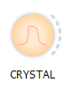
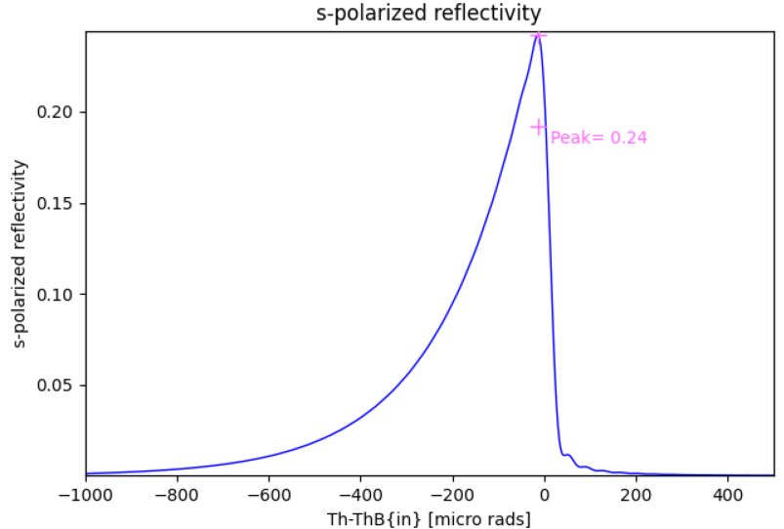
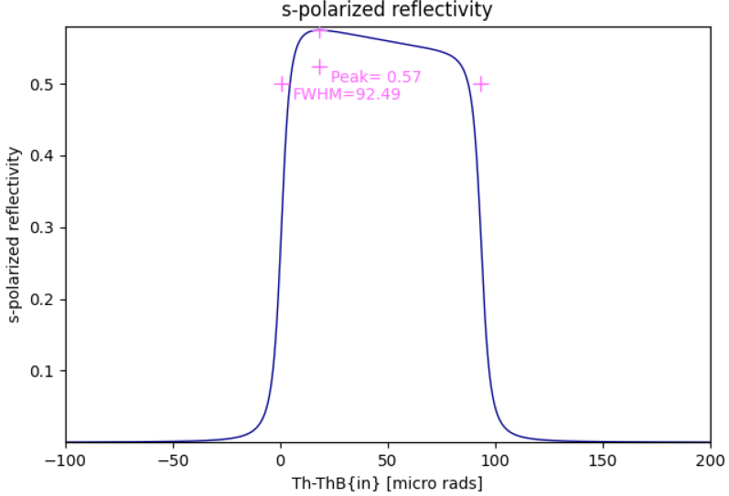
XOPPY-CRYSTAL
Symmetric Bragg
Bent Crystal ML
12 keV
Si(333)
Rm = 0.5 m
Asymmetric Laue (χ=35°)
Bent Crystal PP
30 keV
Si(111)
Rm = 20.0 m
Multilamellar (ML)
Bent Bragg
Bent Laue
Penning-Polder (PP)
Bent Laue
Beamline Optics Design and Simulation Workshop 2025

